Slide 1
Identifying Top GoT Influencers on Twitter
Team DATA IPSUM (latin for data engineering):
Eli Amp, Ramkumar Rajabathar Babu Jai Shanker, Chris Stavropoulos

Slide 2
Agenda
Background
Business Use Case
Influencer
Goal of Analysis
Sources and Tools
Data Sources and Model
Data Storage & Privacy
Data Architecture and Pipeline
Data Analysis
Lessons and Challenges
Next Steps

Slide 3

Background
Game of Thrones is a television Series on HBO
GoT debuted in 2011 and has released seven season as of 2018
The last season will debut in 2019 (Season 8)
In 2012 Vulture.com ranked the series' fans as the most devoted in popular culture, more so than Lady Gaga's, Justin Bieber's, Harry Potter's or Star Wars'.

Slide 4
Business Use Case
Problem
Identify and rank the Twitter influencers for a TV series on HBO
Why?
Twitter influencers can engage a passionate audience and drive higher ratings
Identifying the celebrities that are popular to HBO’s audience. This can help determine which actor would be a candidate for a new HBO series and can help promote the series.
How?
Create a database on the cast, influencers, ratings, and their twitter information
Based on that data create an influencer formula for decision makers

Slide 5
What is an Influencer?
An individual who has the power to affect purchase decisions of others because of his/her authority, knowledge, position or relationship with his/her audience.
Individuals who are passionate, vocal, and may engage a large audience on Social Media
https://www.google.com/search?client=safari&rls=en&q=what+is+an+influencer&ie=UTF-8&oe=UTF-8

Slide 6
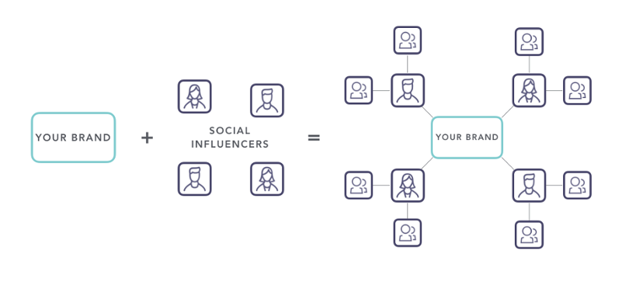
Why Utilize an Influencer?
Fantastic marketing tool for companies looking to quick and affective approach to reach a wide audience.
Influencers bring credibility, relatability, and trustworthiness to your brand.
For each dollar spent on influencer marketing, marketers see an average of $7.65 in earned media value returned.
https://medium.com/crobox/under-the-influence-the-power-of-social-media-influencers-5192571083c3

Slide 7
Types of Influencers
CELEBRITIES
Cast Members of the series Games of Thrones
MICROINFLUENCER
Normal everyday people who have become known for their knowledge about some specialist niche.

Slide 8
Goal of analysis
The goal is to rank and identify the most influencer cast members and twitter users for the GoT tv series.
How will we accomplish this?
Create a Games of Thrones database with TV series information
Collect twitter user “tweets” and upload to BigQuery
Collect IMDb review text for series
Create an influential Score formula and apply to both cast and user data
Create Dashboards of the Top Influencers

Slide 9





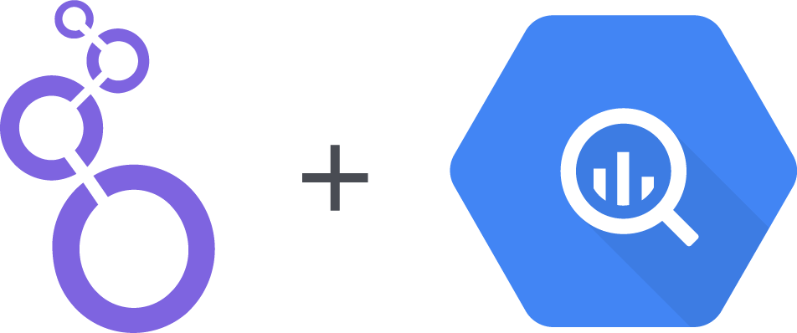



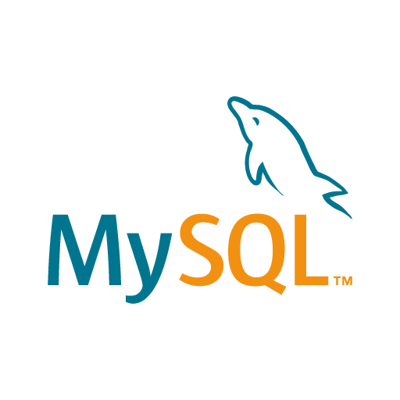



Sources & Tools
SOURCES
INGESTION & CLEANING
STORAGE
DELIVERY & INSIGHTS
Cloud
Pub Sub
Cloud
SQL
Tableau
Server
Twitter
Open
Refine
Google
BigQuery
Data
Studio
GoT API
Microsoft
Excel
MySql
IMDb
Python
RStudio

Slide 10
Data Source & Model: Structured Data Set

Slide 11
Structured Data Set
GoT API
IMDb

Slide 12
Structured Data Set
OpenRefine
GoT API
IMDb
Excel

Slide 13
Structured Data Set
OpenRefine
MySQL
GoT API
IMDb
Excel
Cloud SQL

Slide 14
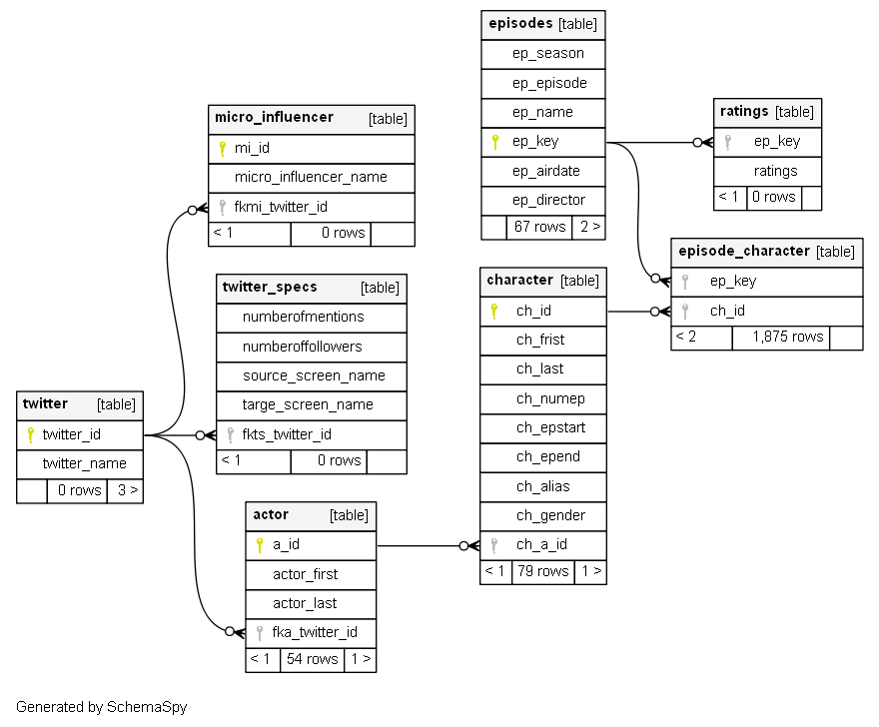
Structured Data Set
ER Diagram

Slide 15
Data Source & Model: Real Time Collection

Slide 16
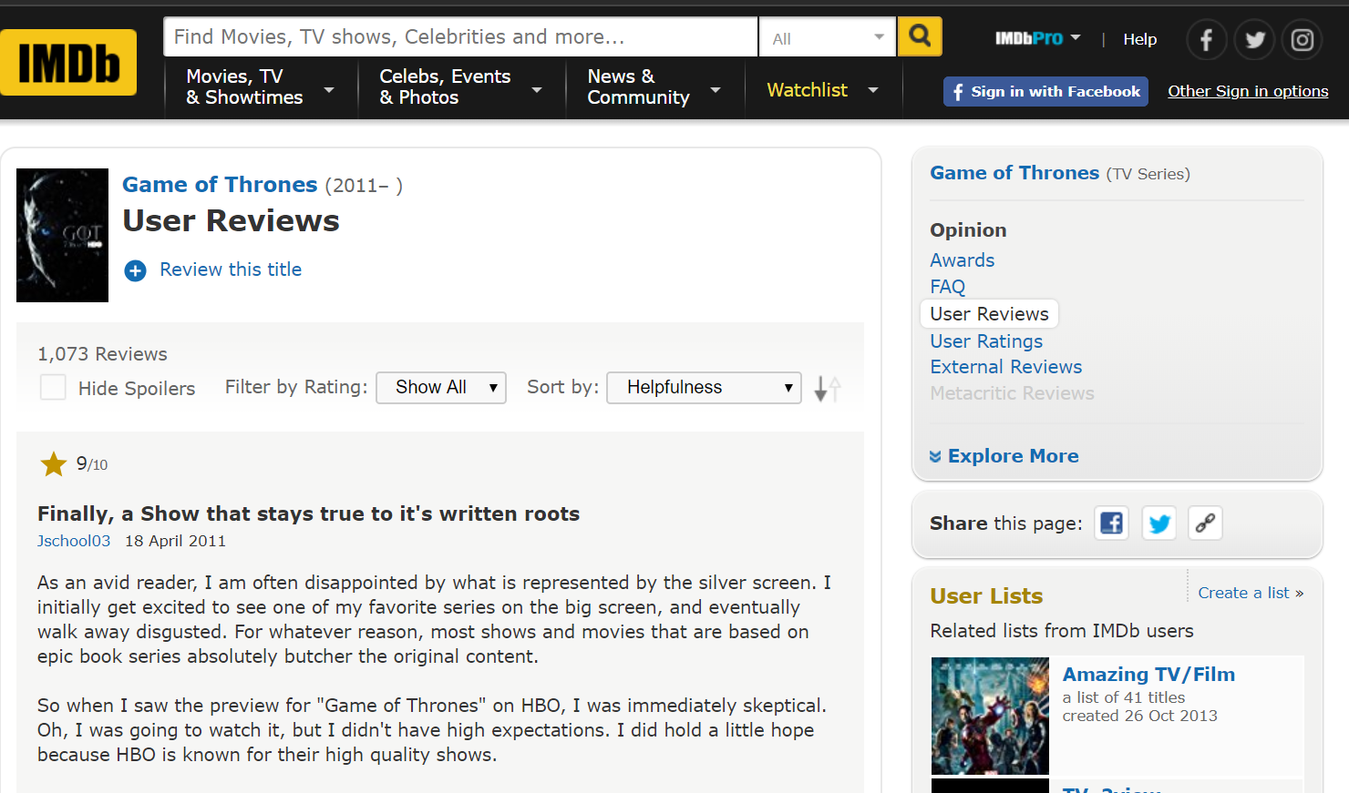

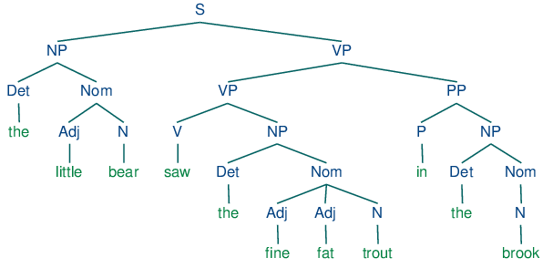

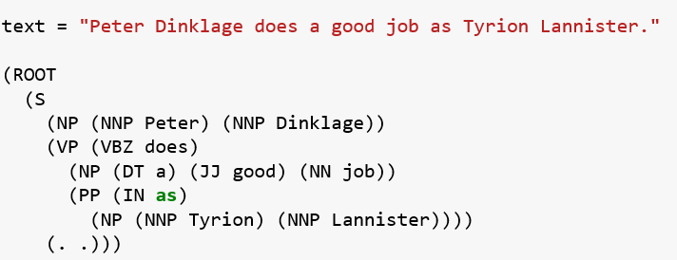
Data Preparation
Data Source
Data Ingestion & Cleaning
Data Storage & Analysis
Merge to CloudSQL
Data Analysis
User reviews by episode
Contains Mentions of actor names
Can talk about both positives and negatives of actor
Data type: Text
Using Requests & Beautiful Soup packages
Cleaned up stop words, punctuation, and other misleading components
Used NLTK package to tokenize and Parse sentence structures (for separating positive and negative review mentions) JSON Output
Review Mentions
Find actor names in reviews
?
Used Episode Number eg. “s01e1”, Cast names eg. “Peter Dinklage” as keys to map into Cloud SQL
Data Storage
JSON
Store sentences in nested records
Mine using structures using “where” or elemMatch operator
Record
-> Noun – Peter Dinklage
-> VP V - does
ADJ good

Slide 17
REAL TIME COLLECTION

Slide 18
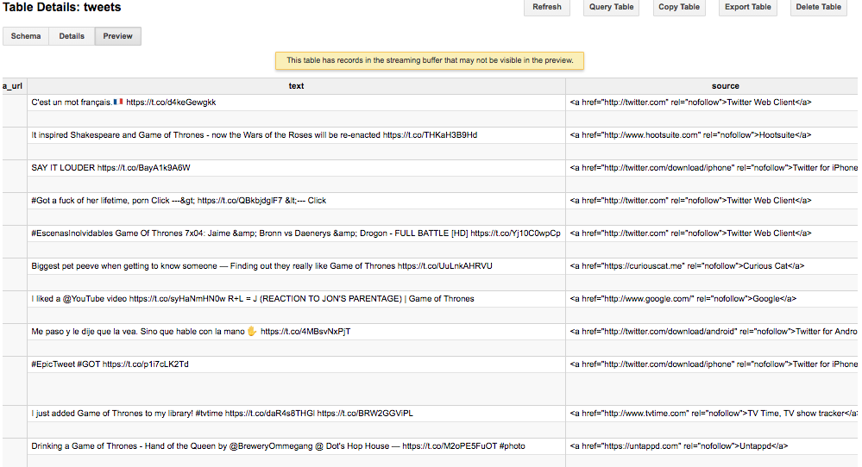

REAL TIME COLLECTION
Cloud Pub/Sub
BigQuery

Slide 19
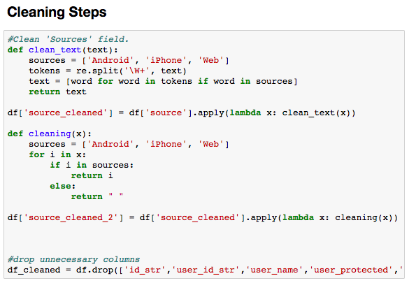
REAL TIME COLLECTION
Cloud Pub/Sub
BigQuery

Slide 20
REAL TIME COLLECTION
Cloud Pub/Sub
BigQuery
Cloud SQL

Slide 21
Data Source & Model: Unstructured Data

Slide 22
Data Storage
Cloud SQL storage chose for its high availability and easy accessibility since the visualizations are near real-time
Cloud SQL chosen because of its fully managed nature. (Routine backups, etc)
BigQuery was chosen because of its hybrid nature – can handle both SQL & NOSQL
Scalability from 1-week to multiple weeks based on chosen timeframe
Cloud SQL
BigQuery

Slide 23


Logical Data Architecture
Data Ingestion
Storage
Platform
Relational Databases
Characters & Episode data
Cloud SQL
Cloud storage for both
Structured & unstructured data
Twitter
Streaming & User data
Design Considera-tions
Data sources have easy to use open-source APIs that can be implemented on Python
Cloud storage chose for its high availability and easy accessibility since the visualizations are near real-time
BigQuery was chosen because of its hybrid nature – can handle both SQL & NOSQL
Scalability from 1-week to multiple weeks based on chosen timeframe

Slide 24
Logical Data Architecture
Data Ingestion
Storage
Delivery & Insights
Platform
Relational Databases
Characters & Episode data
Tableau Server
Host dashboard with
Insights & Visualizations
Google BigQuery
Perform Analysis &
Stage final databases
Cloud SQL
Cloud storage for both
Structured & unstructured data
Twitter
Streaming & User data
RStudio
Calculate Influential
Score
Design Considera-tions
Data sources have easy to use open-source APIs that can be implemented on Python
Cloud storage chose for its high availability and easy accessibility since the visualizations are near real-time
BigQuery was chosen because of its hybrid nature – can handle both SQL & NOSQL
Scalability from 1-week to multiple weeks based on chosen timeframe
Cloud SQL chosen because of its easy integration with BigQuery storage to implement Influence Score calculation
Tableau Server hosts dashboards on web so end-users need only a web URL with no other software requirements
Rstudio was chosen for its calculation of the influential score.

Slide 25

Privacy of Data
To collect Twitter data, we agreed to twitters developer agreement and policy
Twitter requires developers to respect the users control and privacy of data
We added a constraint to the data set to exclude any tweets from protected accounts to protect that users privacy
It’s important to consider how user data is used, where its being stored and who has access to this data
Twitter Developer Agreement
and Policy

Slide 26
Data Analysis: MICROINFLUENCER

Slide 27
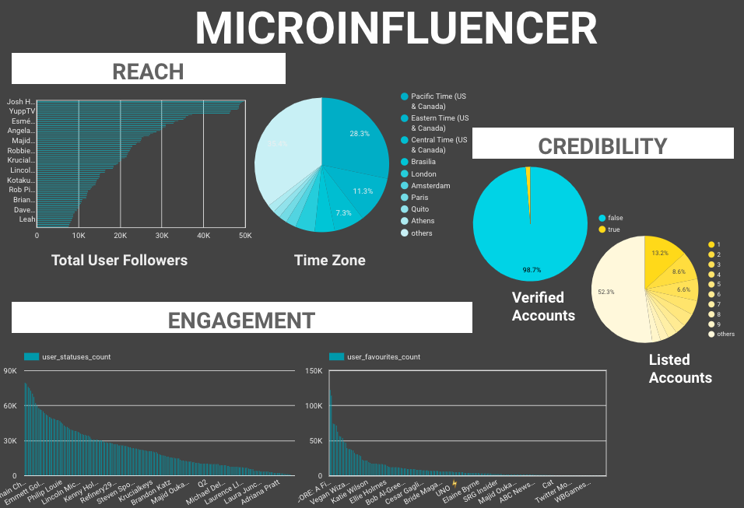
MICROINFLUENCER ANALYSIS
INITIAL FINDINGS
Number of Followers and Statuses data highly skewed due to official corporate accounts. (@gameofthrones, etc)
Over 50% of users tweeting about GoT came from U.S. time zones.

Slide 28
MICROINFLUENCER ANALYSIS
INITIAL FINDINGS
Number of Followers and Statuses data highly skewed due to official corporate accounts. (@gameofthrones, etc)
Over 50% of users tweeting about GoT came from U.S. time zones.
REACH
CREDIBILITY
ENGAGEMENT

Slide 29
MICROINFLUENCER ANALYSIS
INITIAL FINDINGS
Number of Followers and Statuses data highly skewed due to official corporate accounts. (@gameofthrones, etc)
Over 50% of users tweeting about GoT came from U.S. time zones.
REACH
CREDIBILITY
ENGAGEMENT

Slide 30
MICROINFLUENCER ANALYSIS
INITIAL FINDINGS
Number of Followers and Statuses data highly skewed due to official corporate accounts. (@gameofthrones, etc)
Over 50% of users tweeting about GoT came from U.S. time zones.
REACH
CREDIBILITY
ENGAGEMENT
Influencer Score
ENGAGEMENT
=
_________________
REACH

Slide 31
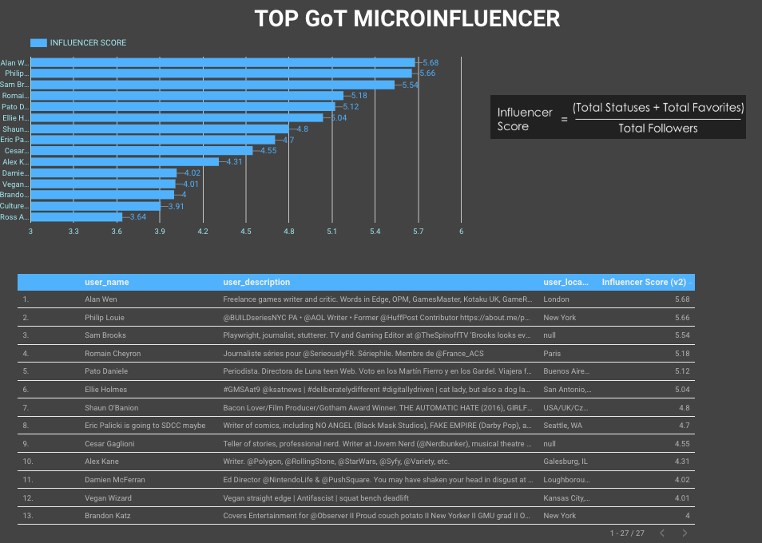
Micro-Influencer Dashboard
Identified top twitter users based on influencer score.
Created a summary of screen name, location, description sorted by score.
Updates in real-time.

Slide 32
Data Analysis: CELEBRITY

Slide 33
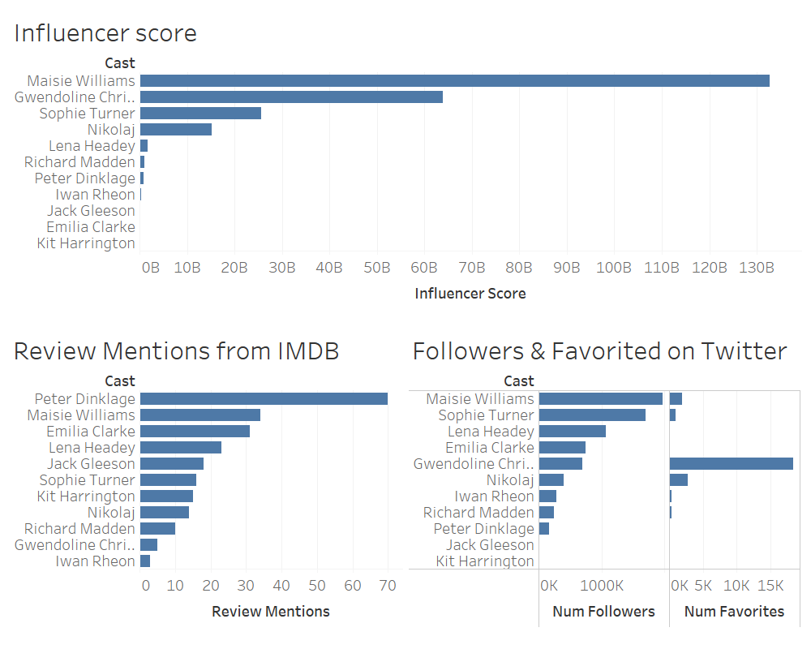
Ranking of Celebrity Influencers
Influencer Score = # Followers on IMDB * # tweets liked * # Review mentions on IMDB

Slide 34
To Conclude…

Slide 35
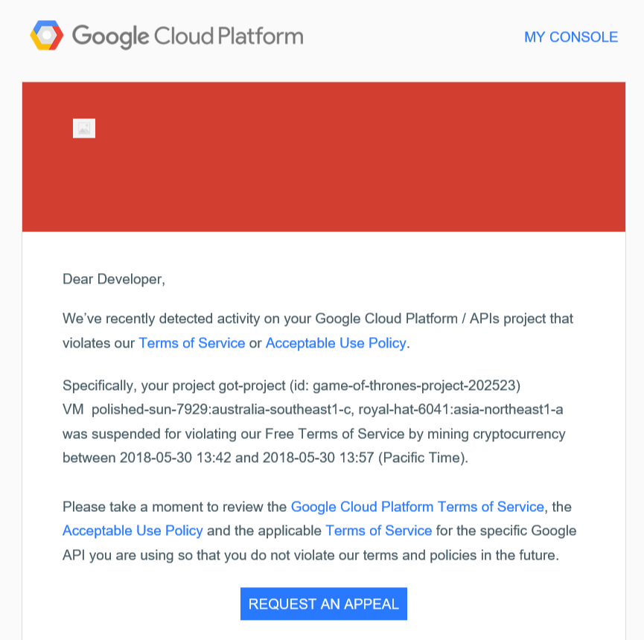
Lessons Learned
Its TRUE, cleaning data is fun (not fun) and takes up a lot of time
Data Sets are not easy to get a hold of and can even be expensive
While exploring different data sets, we kept on asking, “What is the business use case and how can it help the business?”
When handling social media data, be cognizant of user preferences and privacy
Challenges with a third-party server, you don’t have full control of your database. (shutdown several times due to mining cryptocurrency)
Not every cast member has a twitter account
Due to the popularity of the show, there are multiple parody accounts for not only the actor but also each popular character on the show

Slide 36
Journey with GoT Data Sets
First Data set
Battles and Deaths
https://www.kaggle.com/mylesoneill/game-of-thrones
Notes:
Doesn’t tie back to ratings
Data set is fairly clean in csv format
What is the Business Use case?
Second Data Set:
Scene by Scene
https://github.com/jeffreylancaster/game-of-thrones
Notes:
Large data set with multiple episode attributes
Does not have reactionary or ratings data per scene, that would identify influential characters
Geared towards fan analysis rather than Business Analysis
Third Data Set
Past Twitter Data per season
Notes:
Expensive to buy
Would be a very large data set to hold and store

Slide 37
Next Steps…
Automation of data flowing between the platforms
Apply algorithms to clean data as collected
Apply Machine Learning to classify fake accounts
Collection of twitter data for longer periods of time
Collect data from other social media platforms (Facebook, Instagram, Youtube, etc)
Apply to future TV series

